Slide 1

GOOD DOCUMENTATION
PRACTICES
Vishwas Desai
Notes:
http://www.assocham.org/upload/event/recent/event_1197/Mr_Vishwas_Desai.ppt.

Slide 2

GOOD DOCUMENTATION PRACTICES
  Documentation is an essential part and relates to all aspects of GMP
Purpose of documentation
  To ensure that all personnel know what to do and when to do it
  To ensure that authorized persons have all information that are necessary.
  To provide audit trail

Slide 3
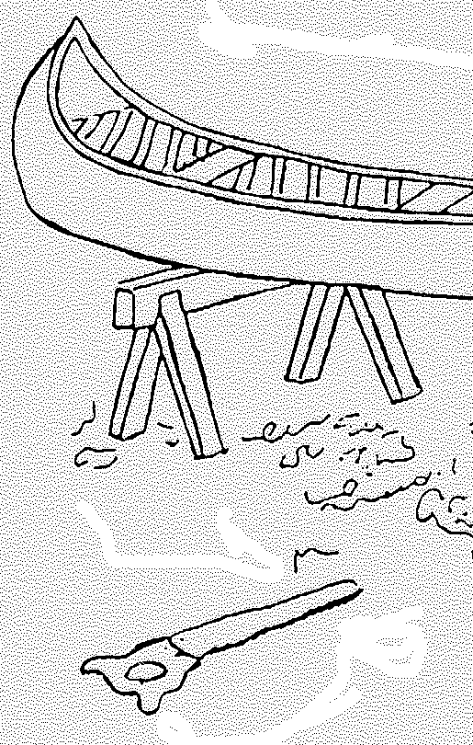
GOOD DOCUMENTATION PRACTICES
What is being made?
Most of us when attempting a task need some sort of documentation

Slide 4
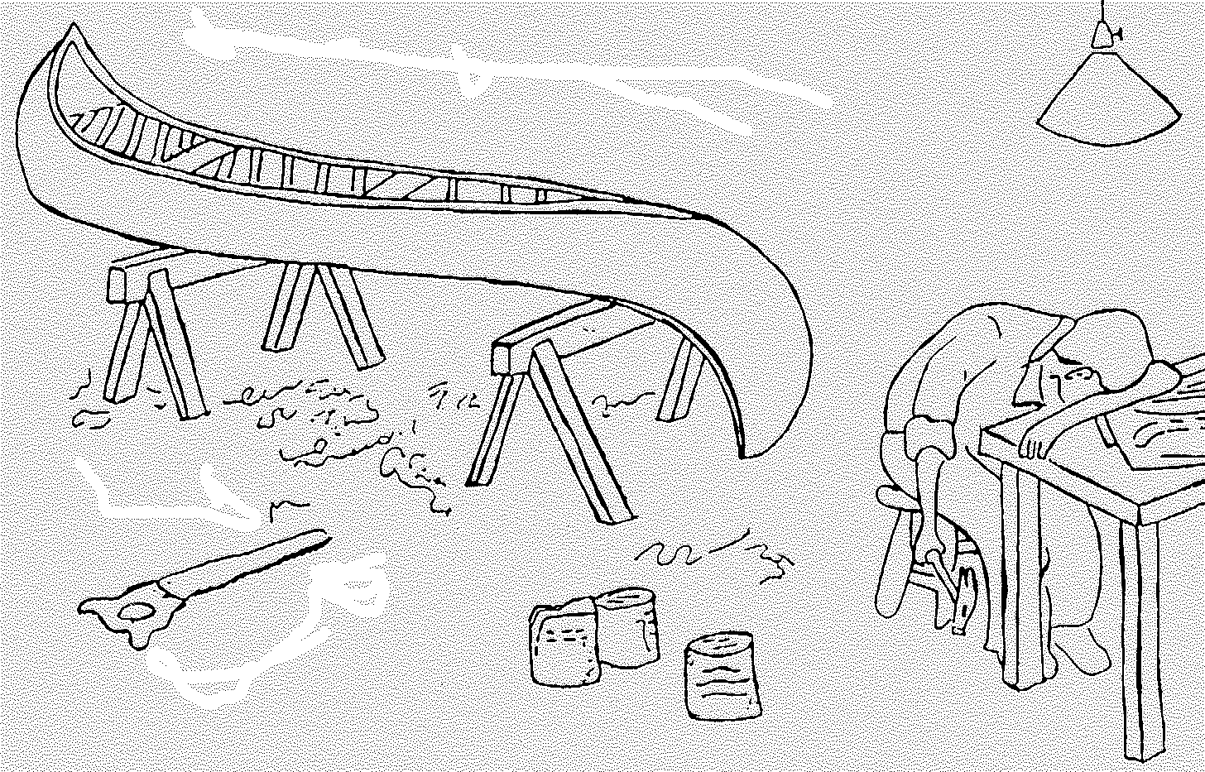
GOOD DOCUMENTATION PRACTICES
And if the drawing is wrong!

Slide 5
GOOD DOCUMENTATION PRACTICES
Why are documents so important?
Communication
Cost
Audit trail

Slide 6
GOOD DOCUMENTATION PRACTICES
Documents should be
  Designed
  Prepared
  Reviewed
  And Distributed with care

Slide 7

GOOD DOCUMENTATION PRACTICES
What are types of Documents ?
Specifications
Standard Operating Procedures
Batch Manufacturing Records (BMR)
Batch Packing Records (BPR)
Forms for recording data
Protocols
Quality System Documents
Labels, specifications and master formulae etc.

Slide 8

GOOD DOCUMENTATION PRACTICES
Specification
This kind of document serve as a basis for quality evaluation.
Quality of incoming materials
Quality of the production environment
Quality of production and control process
Quality of the final product

Slide 9

GOOD DOCUMENTATION PRACTICES
Standard Operating Procedure (SOP)
It give directions for performing certain operations like :
Equipment Operation
Gowning
Environmental control
Cleaning
Sampling
Testing,

Slide 10

GOOD DOCUMENTATION PRACTICES
Batch Manufacturing Record (BMR)
It gives manufacturing formula and processing instructions.

Slide 11
GOOD DOCUMENTATION PRACTICES
Batch Packing Record (BPR)
It gives details of the packing materials and packing instructions.

Slide 12

GOOD DOCUMENTATION PRACTICES
Forms for Recording Data
These documents are used to execute the data of evidence
Example Log books, Environmental monitoring data, various processing records.

Slide 13

GOOD DOCUMENTATION PRACTICES
Protocols
A protocol describes the details of a comprehensive planned study to investigate the consistent operation of new system/equipment, a new procedure, or the acceptability of a new process before it is implemented.
Examples : Validation studies, stability studies, and clinical studies

Slide 14

GOOD DOCUMENTATION PRACTICES
Quality System Documentation
This kind of document reflects total quality concept of the organization by implementing new systems to keep in pace with continuous improvements.
Change control
Deviation
Incident reporting
CAPA
Self Inspection

Slide 15

GOOD DOCUMENTATION PRACTICES
Tips for Good Documentation Practices
Documents should be designed, prepared, reviewed and distributed with care.
Document should comply with the relevant parts of the manufacturing and marketing authorization dossiers.
Documents should be approved, signed and dated by appropriate and authorized persons.

Slide 16
GOOD DOCUMENTATION PRACTICES
Continued…..
Documents should have unambiguous contents; Title, Nature and purpose should be clearly stated.
Document should be laid out in an orderly fashion and be easy to check.
Reproduced documents should be clear and legible.
The reproduction of working documents from master documents must not allow any error to be introduced through the reproduction process.

Slide 17
GOOD DOCUMENTATION PRACTICES
Continued…..
Documents should be regularly reviewed and kept up-to-date.
When a document has been revised, systems should be operated to prevent inadvertent use of superseded documents.
Documents should not be hand-written; although, where documents require the entry of data, these entries may be made in clear, legible, indelible handwriting.
Sufficient space should be provided for such entries.

Slide 18
GOOD DOCUMENTATION PRACTICES
Continued…..
Any alteration made to the entry on a document should be signed and dated; the alteration should permit the reading of the original information. Where appropriate, the reason for the alteration should be recorded.
The records should be made or completed at the time each action is taken and in such a way that all significant activities concerning the manufacture of medicinal products are traceable

Slide 19
GOOD DOCUMENTATION PRACTICES
Continued…..
If documentation is handled by electronic data processing methods,
only authorized persons should be able to enter or modify data in the computer
there should be a record of changes and deletions;
access should be restricted by passwords or other means and the result of entry of critical data should be independently checked.

Slide 20
GOOD DOCUMENTATION PRACTICES
Continued…..
Data may be recorded by electronic data processing systems, photographic or, other reliable means, but detailed procedures relating to the system in use should be available and the accuracy of the records should be checked.
Records electronically stored should be protected by back-up transfer on magnetic tape, microfilm, paper or other means.
It is particularly important that the data are readily available throughout the period of retention,.

Slide 21
GOOD DOCUMENTATION PRACTICES
Correct Procedure for Recording of Data
Enter information using only Ball pens (no pencils or water-soluble pens).
Use only blue ink. In manufacturing areas, use only pens without caps.
Record entry, signature and date immediately following completion of each step or task.
Record only the information resulting from individual performance, verification or observation of task (s) performed.

Slide 22

GOOD DOCUMENTATION PRACTICES
Continued…..
Unused blanks or entries must be marked “NA” (“Not Applicable” this indicates review of the applicable information and not just missed).
If full signature appears on a signature log sheet or within the document , then initials and a corresponding date are acceptable.

Slide 23
GOOD DOCUMENTATION PRACTICES
Continued…..
Same individual cannot perform and approve/verify the same task(s).
One individual performs an action. A second individual approves or verifies that action. The result is completion or confirmation of the specified action.
Use a single line to cross out errors. Sign and date the correction.
The person who made the error should be the one to correct the error. If waiting on that person to return to work causes delays in work activities, an individual who understands the document may make the correction.

Slide 24
GOOD DOCUMENTATION PRACTICES
Continued…..
Do not destroy, erase or otherwise obscure original data.
Do not attempt to write over a number to convert it to another number.
Do not trace over an entry. If the entry is not clear, correct as a general entry error.
Do not line out another individual’s initials/signature.
Avoid using one single cross out to cover multiple incorrect entries.
Each incorrect entry should be independently crossed out.

Slide 25
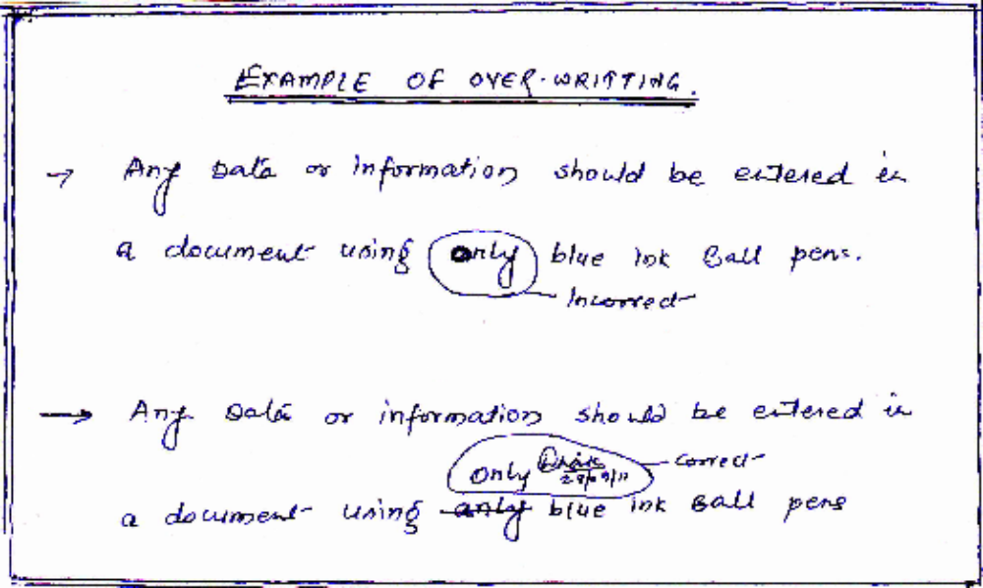
GOOD DOCUMENTATION PRACTICES
Example:1

Slide 26
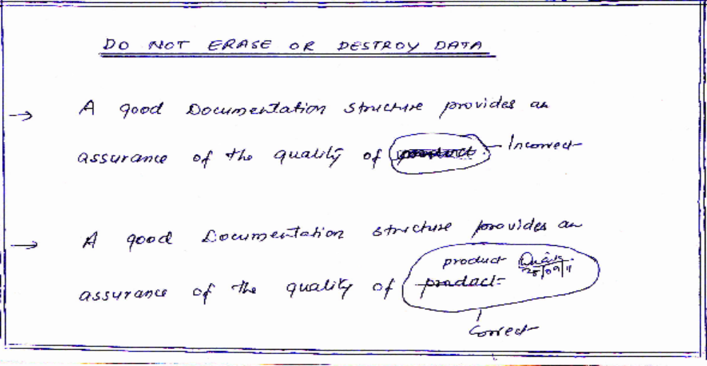
GOOD DOCUMENTATION PRACTICES
Example:2

Slide 27
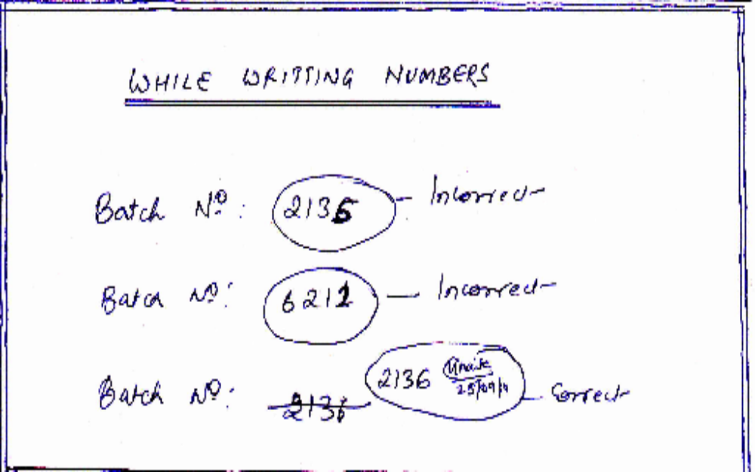
GOOD DOCUMENTATION PRACTICES
Example:3

Slide 28
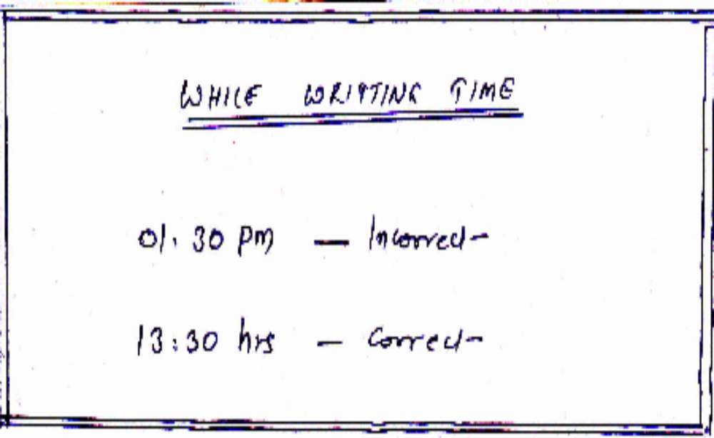
GOOD DOCUMENTATION PRACTICES
Example:4

Slide 29

GOOD DOCUMENTATION PRACTICES
Enter data when testing has not been completed.
Signing for work prior to that work being performed.
Signing for another person’s work with your name.
Using other than today’s date where signature/initials
and date are required.
Do not proceed to

Slide 30
GOOD DOCUMENTATION PRACTICES
Continued ….
Changing original / non-retrievable data without supporting documentation.
Documenting verification of data without individual observation.
Entering or approving data / information using someone else’s log-on identification.

Slide 31
GOOD DOCUMENTATION PRACTICES
A good documentation structure provides an assurance of the quality of product.

Slide 32
GOOD DOCUMENTATION PRACTICES
All documents must be organized into files which must be stored and maintained for specified periods of time after the expiry date of the product and must be easily retrievable.

Slide 33
GOOD DOCUMENTATION PRACTICES
A well-designed documentation system is useful only if it is understood thoroughly by each and every individual.

Slide 34
GOOD DOCUMENTATION PRACTICES
Control and assessment of the documentation system is very critical
1) Changes and revisions
2) Compliance,
3) Improvement in procedures or processes.

Slide 35
Inference
All this is achievable through
Positive attitude
Positive thoughts
Removal of mental blocks
Open to change
Destruction of Ego

Slide 36
Thank You

